Slide 1
Architect/Manager Project
Xuanbin, Zhang

Slide 2
Agenda
Big Map
Schedule
Hardware
OS
Hadoop
AWS
Data Lake
BI—Tableau
PMP
Data analyze

Slide 3
Architect/Manager Big Map
⑦PMP
⑧Data analyze & ⑥Display
⑤DataLake
③Hadoop
④AWS
⑨Openstack
②OS
①HardWare

Slide 4
Schedule
Items | Time Line
 | M8 |  |  |  | M9 |  |  |  | M10 |  |  |  | M11 |  |  |  | M12
 | W1 | W2 | W3 | W4 | W1 | W2 | W3 | W4 | W1 | W2 | W3 | W4 | W1 | W2 | W3 | W4 | W1 | W2 | W3 | W4
①
②
③
④
⑤
⑥
⑦
⑧
⑨
Notes:
Ansible

Slide 5
Request
20 services will use 15PB data, please choose the hardware, design the data center, network, OS, big data platform.
1. Hardware
2. Datacenter design
3. network design
4. OS design/automation
5. OS installation/Monitoring
6. Hadoop cluster design
7. Hadoop cluster installation/Monitoring
8. Data lake design/implement
9. Service supply

Slide 6
Server component
Power
CPU
Memory
Disk
Mother Board
Network interface Card

Slide 7
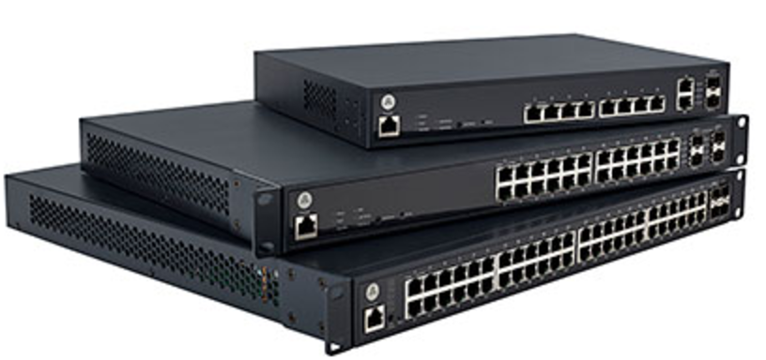
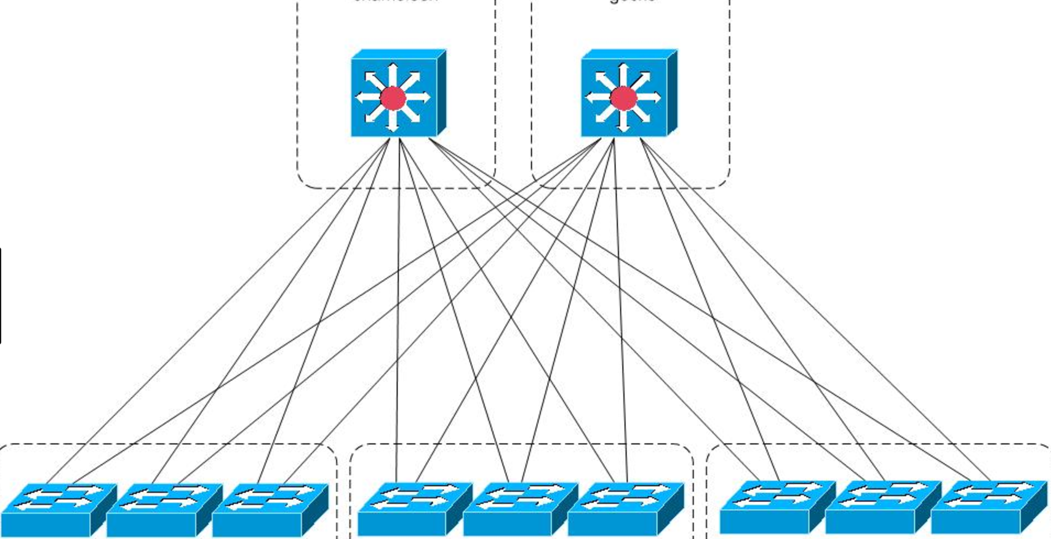
Switch

Slide 8
Server
Dell
1U-R420,430,620,630
2U-R720,730,815
IBM
1U-3550
2U-3650
4U-
HP
2U-
Weihua
1U-
2U-U-

Slide 9
Remote Control
Dell
iDRAC
IBM
BMC
HP
iLO

Slide 10
Agenda
Aws practice env prepare
01_Configure a local HDP repository
02_Install ambari-server and ambari-agent
03_Install HDP using the Ambari install wizard
04_Add a new node to an existing cluster
05_Decommission a node
06_Add an HDP service to a cluster using Ambari
07_Define and deploy a rack topology script
08_Change the configuration of a service using Ambari
09_Configure the Capacity Scheduler
10_Configure the location of log files for services
11_Create a home directory for a user and configure permissions
12_Configure the include and exclude DataNode files
13_Restart an HDP service
14_View an application’s log file
15_Configure and manage alerts
16_Troubleshoot a failed job
17_Configure NameNode HA
18_Configure ResourceManager HA
19_Copy data between two clusters using distcp
20_Create a snapshot of an HDFS directory
21_Recover a snapshot
22_Configure HiveServer2 HA

Slide 11
Agenda
1.

Slide 12
Agenda
Aws practice env prepare
01_Configure a local HDP repository
02_Install ambari-server and ambari-agent
03_Install HDP using the Ambari install wizard
04_Add a new node to an existing cluster
05_Decommission a node
06_Add an HDP service to a cluster using Ambari
07_Define and deploy a rack topology script
08_Change the configuration of a service using Ambari
09_Configure the Capacity Scheduler
10_Configure the location of log files for services
11_Create a home directory for a user and configure permissions
12_Configure the include and exclude DataNode files
13_Restart an HDP service
14_View an application’s log file
15_Configure and manage alerts
16_Troubleshoot a failed job
17_Configure NameNode HA
18_Configure ResourceManager HA
19_Copy data between two clusters using distcp
20_Create a snapshot of an HDFS directory
21_Recover a snapshot
22_Configure HiveServer2 HA

Slide 13
Agenda
Install(PXE + Kickstart)
Virtualization(KVM, Xen, Virtualbox, vagrant)
OS Optimization
100 commands(filesystem, management, network, monitor…)
Automation(Ansible, slatstack, Chef)
Zabbix, Shinken
Yum repo
Rpm Package
50 nodes server arch design

Slide 14
Agenda
Distributed File System
HDFS
Distributed Yarn

